Slide 1
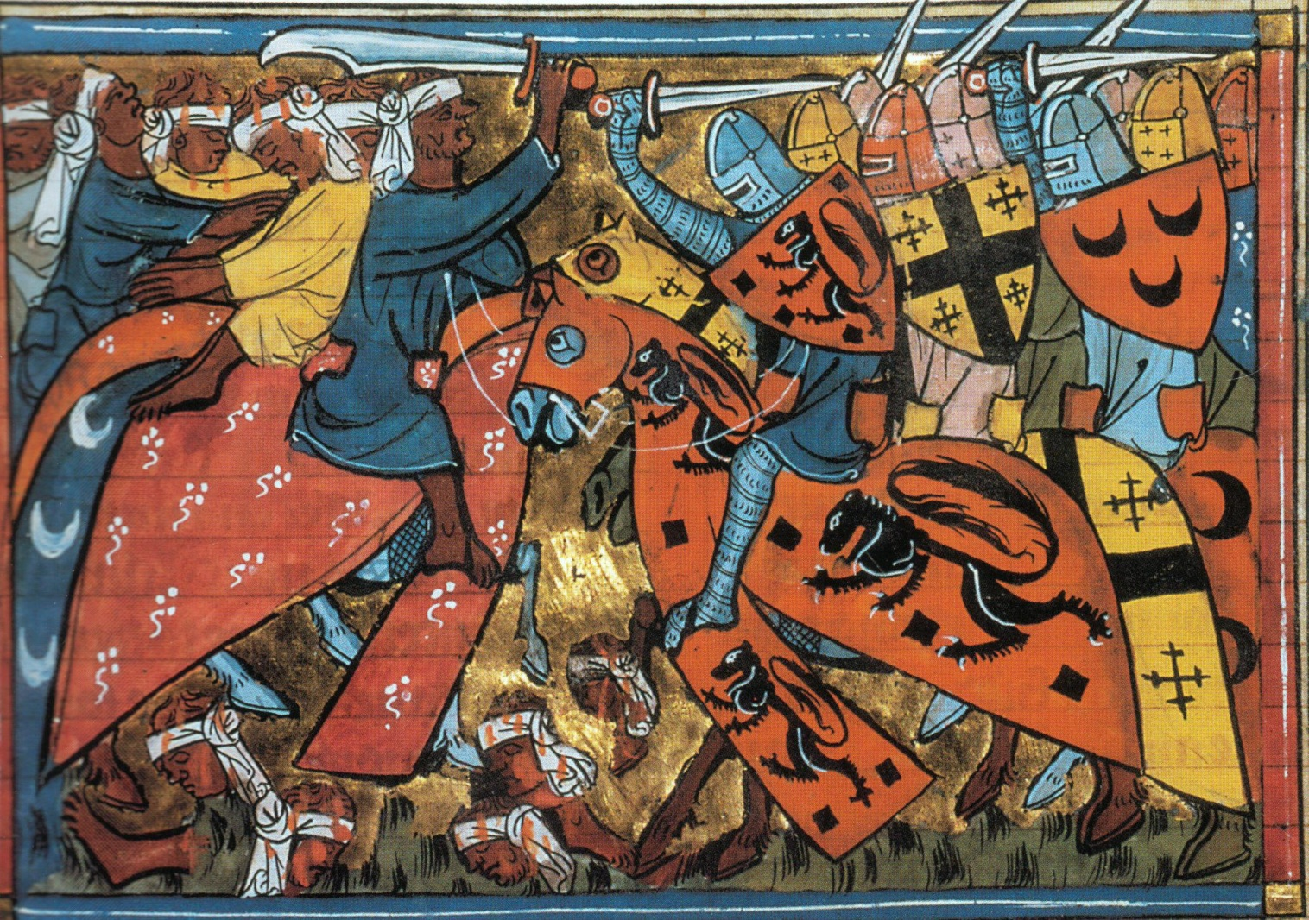
The Middle Ages: Introduction

Slide 2
Learning Intentions (goals) By the end of this PowerPoint you will: 1) Know when the Three Stages of the Middle Ages were. 2) Know some of the key events from the topic. 3) Define several key terms. 4) Know the key event the Unit focuses upon.

Slide 3
What was the Middle Ages the ‘Middle’ of?
The Middle Ages was the period of European history between 500AD and 1500AD.
Other names for this period include the Dark Ages and the Age of Religion.
The most common name for this period is the Medieval Period.
‘Medieval’ is the Latin Term for the ‘Middle Ages’ (it comes from the same word that gave us Median in mathematics).
Looking at the names given by historians to the years 500 to 1500 what assumptions might we make about life in this period?

Slide 4
The Early Middle Ages (550 – 1000)
Key Events:
End of the Roman Empire
The Rise of Islam
The rule of Barbarian Kings.
Charlemagne creates the Carolingian Empire.
Europe terrified by waves of invaders.
The emergence of Knights and Feudalism.

Slide 5
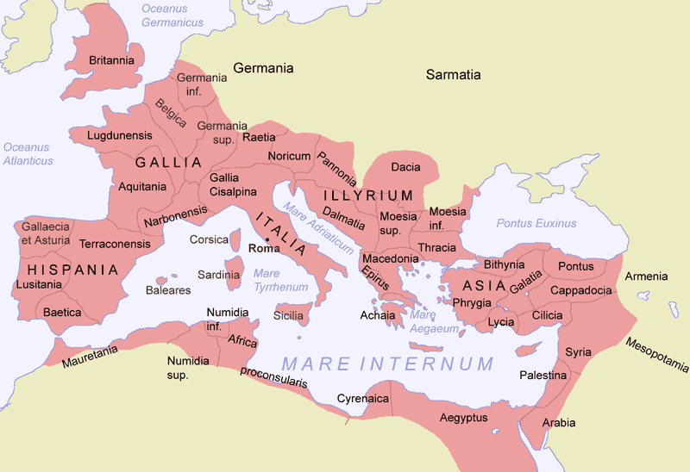
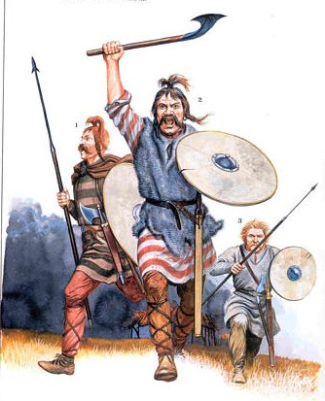
The beginning of the Middle
The Middle Ages begins with the Fall of the Roman Empire in 476.
The Romans had ruled provinces in Europe, the Middle East and North Africa for nearly a thousand years.
Challenges to Roman security increased during the first century (0-100 AD) as tribes from Germania (Germany) began to confront the Romans.

Slide 6
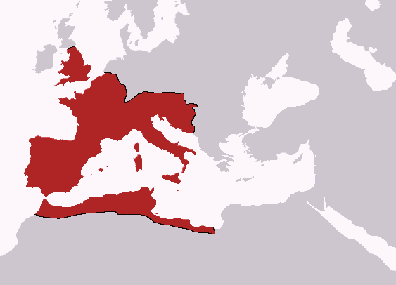
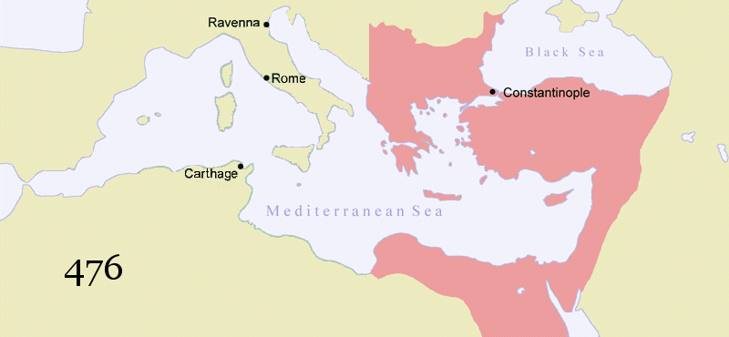
Division of Rome
One of the consequences of the weakening of Rome was the division of the Roman Empire.
This was intended to make governing easier.
In 376 AD the Empire was divided into two:
The Western Roman Empire (capital city of Rome)
The Eastern Roman Empire (capital city of Constantinople)
Eastern Roman Empire was also known as the Byzantine Empire

Slide 7
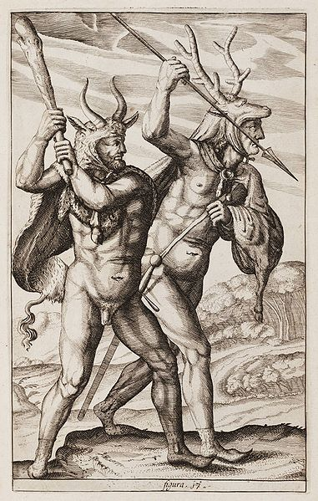
The Barbarians takeover
By the end of the 400s Rome had been weakened by political instability.
Roman legions were stretched thin across an empire that was becoming too large to defend easily.
German tribes such as the Goths, Visigoths, Vandals, Angles and Saxons took advantage of this weakness.
In 476 the Visigoth King Odovocar removed the last Western Roman Ruler from power.

Slide 8
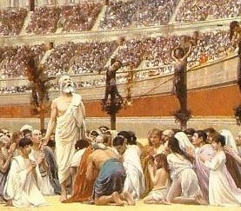
Rome’s greatest legacy - Christianity
The Barbarians desired the farmlands, roads and wealth of the Western Roman Empire.
The unintended consequence of conquest was that the tribes spread the Christian faith throughout all the peoples of Europe.
Rome’s official religion since 395 had been Christianity.
This ended nearly three centuries of persecution of Christians (including being burned alive, crucified and thrown into the gladiatorial arenas).
Their was only one recognised church (the Roman Catholic). The Pope is the head of the church.

Slide 9
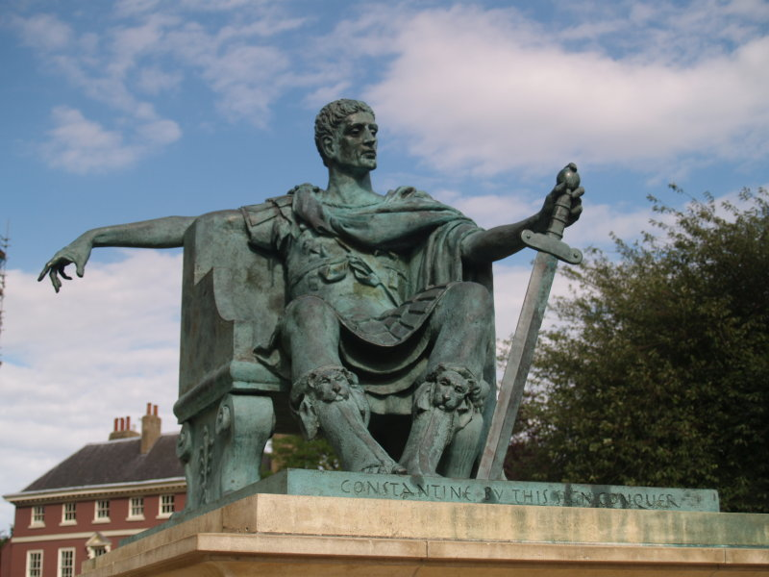
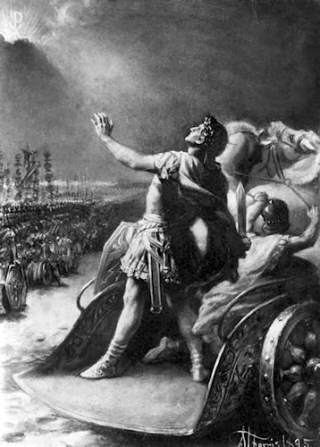
Rome’s greatest legacy - Christianity
Christianity became the official religion of Rome following the conversion of Emperor Constantine in 312.
Constantine converted after he claimed to experience a vision of a flaming cross in the sky before a battle.
He promised to convert to Christianity and succeeded in the battle.
Some historians argue that the real reason was it secured the loyalty of Christians in his army (who were becoming a significant and influential group).

Slide 10
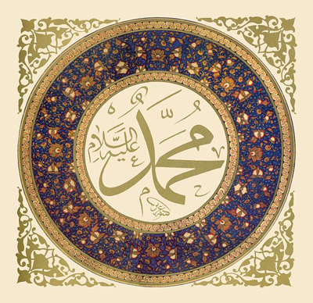
The Rise of Islam
Christianity had started as an obscure Jewish sect (religion with a small number of followers).
The conversion of Constantine and the Barbarian conquerors ensured that it defined European culture throughout the Middle Ages.
24 years after the fall of western Rome a religious leader was born in Saudi Arabia whose vision would challenge the Christian world view – Muhammed.

Slide 11
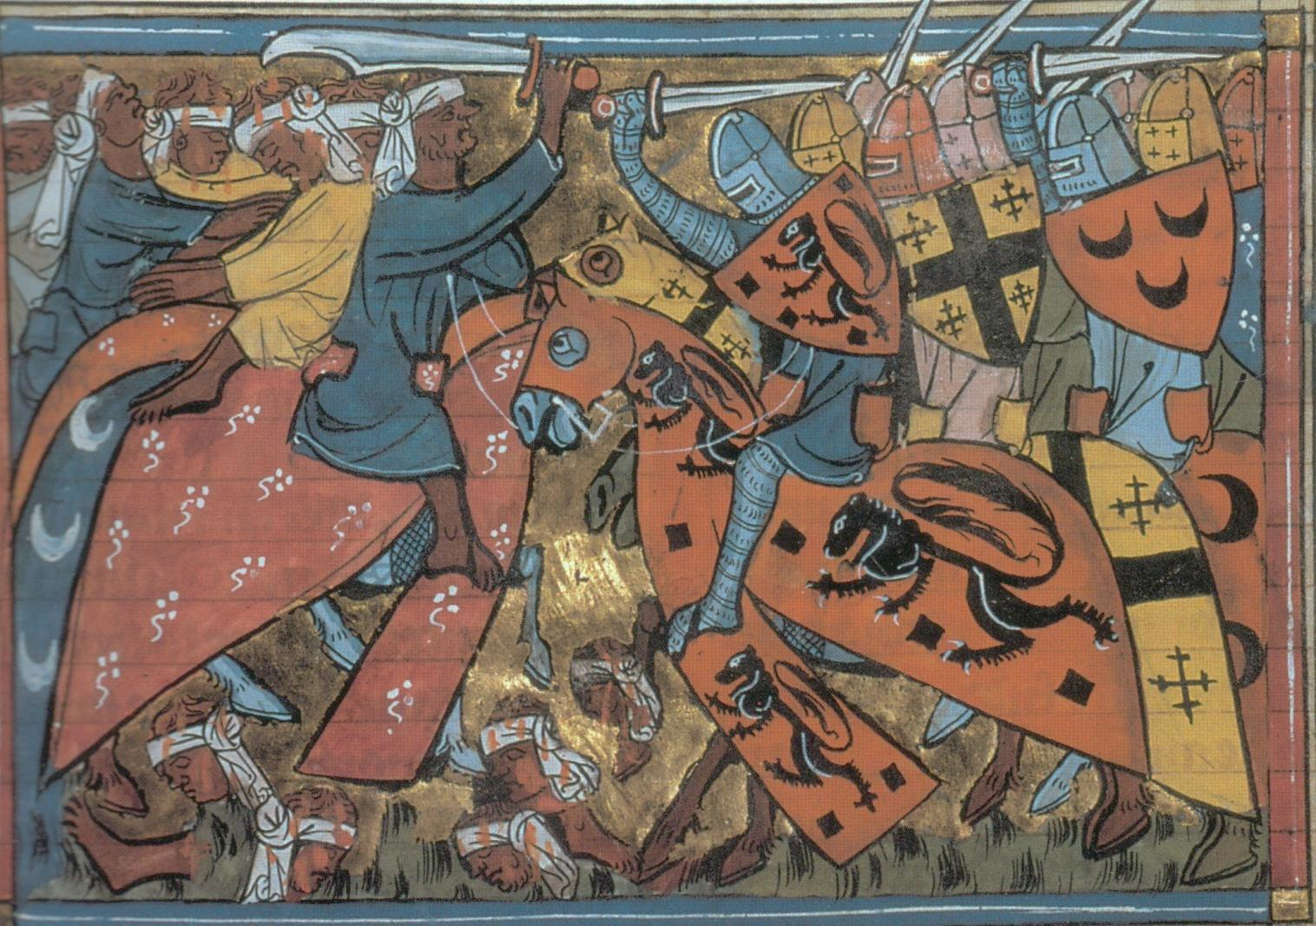
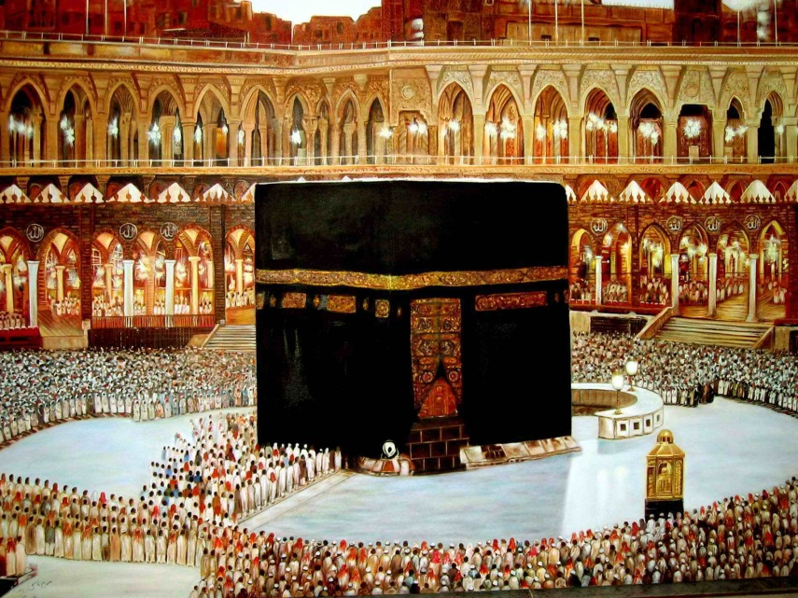
The Spread of Islam
Muhammad was the prophet of the faith of Islam.
The Islamic Holy Book (The Koran) was the final authority on faith and lifestyle for the followers of Islam. It was recited by Muhammed after receiving a vision from Allah.
Like Christianity, Islam is a monotheistic religion (acknowledging only one God).
Although the Koran mentions both Mary and Jesus respectfully it states that Jesus was another prophet (and not the Son of God or divine).
Reasons why tension between the Christian West and Islamic East were inevitable:
Both religions claimed to be the One True Faith.
Both religions came from the Middle East and claimed similar places as Holy (e.g. Jerusalem)
Islamic Empires spread rapidly – and managed to conquer parts of Europe

Slide 12
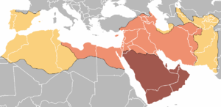
The Islamic Empire
Expansion under Muhammed, 622-632
Expansion during the period 632-661
Expansion during the period 661-750

Slide 13
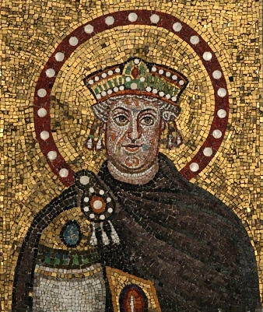
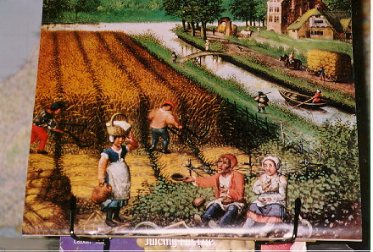
The New Medieval World
The end of the Western Roman Empire meant that the political unity of Europe had collapsed.
In response, the German tribes formed their own kingdoms.
Their Kings had limited power so relied upon the loyalty of local land owners (called Lords).

Slide 14
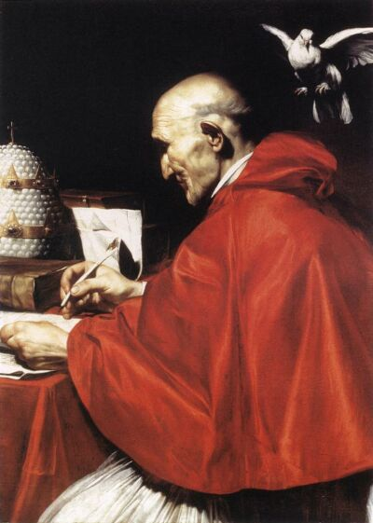
The Rise of the Medieval Church
The main source of continuity from Roman to Medieval times was the church.
The Catholic Church had arranged diplomatic meetings with the leaders of barbarian tribes before the Fall of Rome.
It also sent waves of missionaries into German tribal areas (successfully!).
The leader of the Church (the Pope) became a symbol of unity at a time of great disruption.

Slide 15
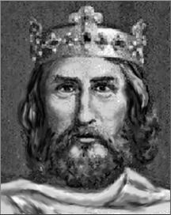
Charlemagne the Warrior (b742-d814)
A German prince called Charlemagne was determined to unite the different kingdoms of Europe.
He was famous for his athleticism and intelligence although like most leaders he was illiterate (He slept with a book under his pillow in the hope of absorbing the ability to read!).
Starting in 774 he embarked on over 50 military campaigns.
In 779 Pope Leo III was driven out of Rome by an angry mob (who were angered by his ‘common’ birth and accused him of adultery and perjury!).
Charlemagne sent an army to protect the Pope. In return, the grateful Pope named Charlemagne the head of the “HOLY ROMAN EMPIRE”.

Slide 16
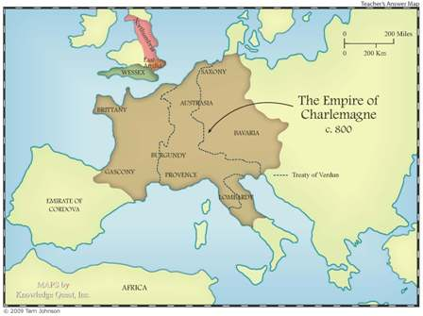
Charlemagne the Great
Odd facts
‘Carolingian’ just means ‘Descendents of Charles’
The FIRST Charles was ‘Charles Martel’ – the grandfather of Charlemagne. The Empire was named after this common family name.
Some of the Charles which followed after the death of Charlemagne included:
CHARLES THE FAT, CHARLES THE BALD AND CHARLES THE SIMPLE!
Fast facts:
Charlemagne’s empire (known as the CAROLINGIAN EMPIRE) was the largest since the Roman Empire.
Charlemagne refused to allow any of his five daughters to wed (in case their husbands attempted to remove him!).

Slide 17
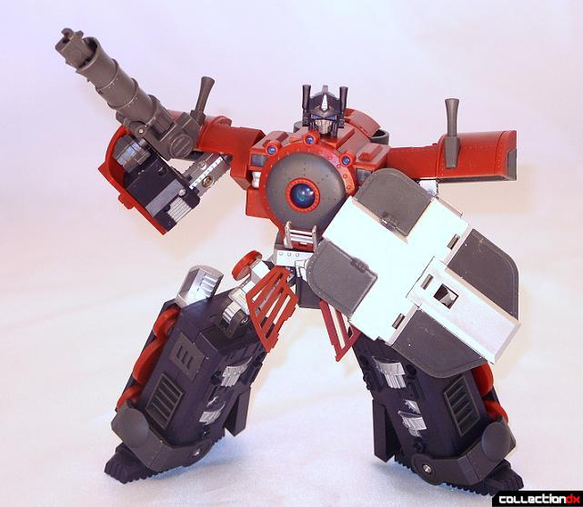
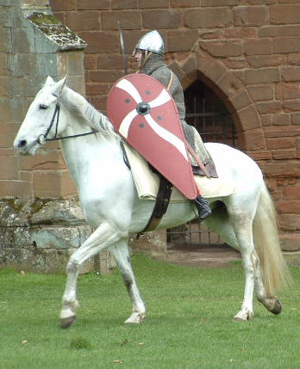
It’s not the Middle Ages as we know it!
For the first 500 years of the Middle Ages there were NO large castles or ‘Knights in Shining Armour’.
These developed in response to three waves of invasions that were so terrifying they completely changed how Medieval Society was organised.
The three invasions came from completely different societies and effectively surrounded the Kingdoms of mainland Western Europe.
They happened during the 800s and 900s.
………Can you guess the three types of invader?
Kill the Myth!
For the first 500 years of the ‘Middle Ages’ the sight of a man in armour on a horse would be like seeing a Transformer in battle today!

Slide 18
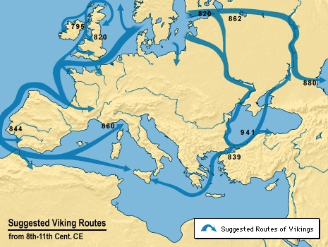
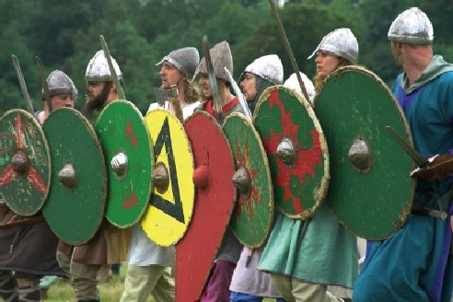
The Three Invasions – The Vikings
The Vikings came from Denmark, Sweden and Norway.
Due to overpopulation and the harshness of their rocky and cold environment they set out on a series of raids.
The brutality and speed of their attacks made them the most feared threat to Western Europe.
The goals of their invasions differed. In some areas they simply raided monasteries and towns and carried off the treasure, food, women and slaves they needed.
In other cases (such as the region called Normandy) they settled permanently.

Slide 19
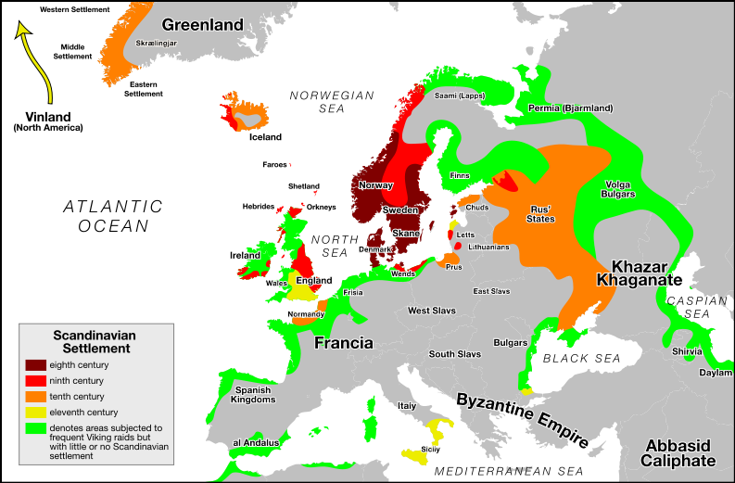
The Three Invasions – The Vikings
Fast Facts
The Vikings never wore horned helmets!
They managed to travel as far as North America!
Viking Mythology gave us the superhero ‘Thor’.
The D-Day landing in World War Two took place at Normandy.
Normandy was named after the ‘Northmen’ – the Vikings.
They forced one of the Charles (Charles the Simple) to give them the land in 911 in return for an end to raids on neighbouring land.

Slide 20
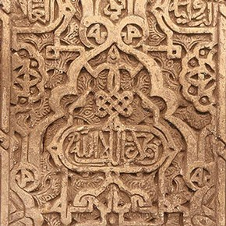
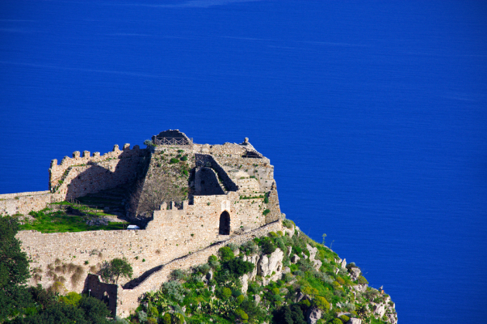
The Three Invasions – The Islamic
As the Vikings attacked the North and coastal Europe Islamic raids attacked the south.
Muslim forces controlled the islands of Sicily in the Mediterranean and southern Spain.
They used fortresses in these regions to attack Western Europe. Fortresses were also built in France so merchants could be raided.
Muslim forces besieged Rome in 846 and plundered the cathedrals of St. Peter and Paul (although they never raided the city itself). They also destroyed a religious centre at Monte Cassino.
The former Eastern Roman Empire (Byzantine) had to deal with repeated raids because it was so close to the Middle East.

Slide 21
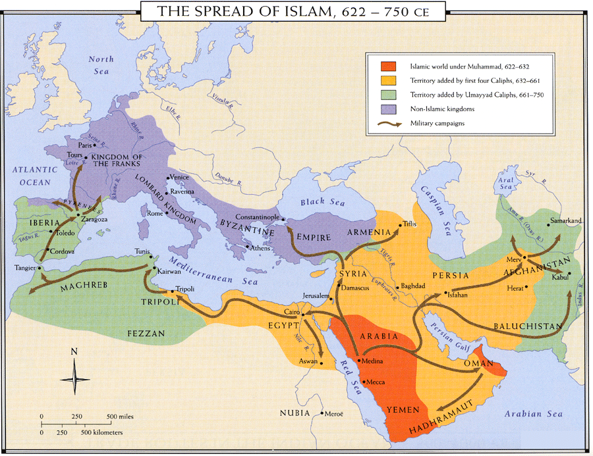
Fast Facts
The Byzantine Empire suffered the most from Muslim raids.
These conflicts were part of the reason for the Crusades (which begin in 1096)
SARACEN was the name given to the Muslim raiders (it just means ‘Easterner’)

Slide 22
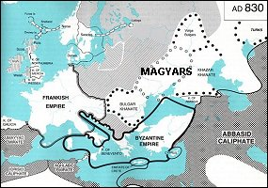
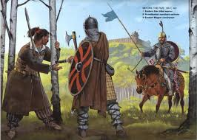
The Three Invasions – The Magyars
The Magyars originally came from Western Russia.
Like another ‘barbarian’ tribe (The Huns) they were excellent horseman and could shoot arrows while riding.
They carried out a series of raids and managed to left a path of destruction from Eastern Europe to Southern Germany.
Their invasions were stopped in 955 when a German King called Otto the Great defeated them.
Odd Facts
Part of the reason for Magyar success was that their horsemen used stirrups.
This made it easy to ride and fight without falling off a horse.
Western Europe had not invented these yet!
Hungary is named after the Magyars (who reminded people of the Huns).

Slide 23
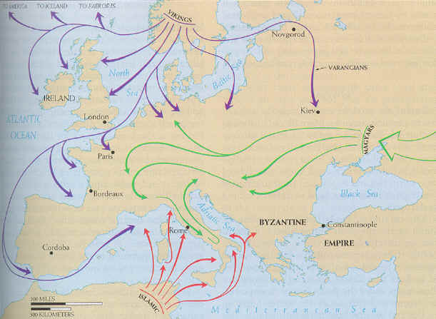
Medieval Europe – Threatened from all sides.

Slide 24
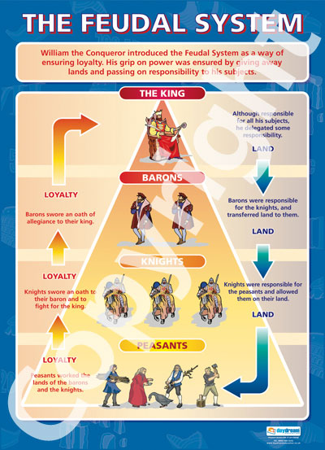
The Medieval response: Feudalism
The waves of invaders and raiders during the 800s and 900s made central control of Europe very difficult.
A system based on local power and loyalty emerged. This was known as FEUDALISM.
FEUDALISM: A political and social system that tied together Kings, Lords and Peasants in a relationship based upon loyalty and land.

Slide 26
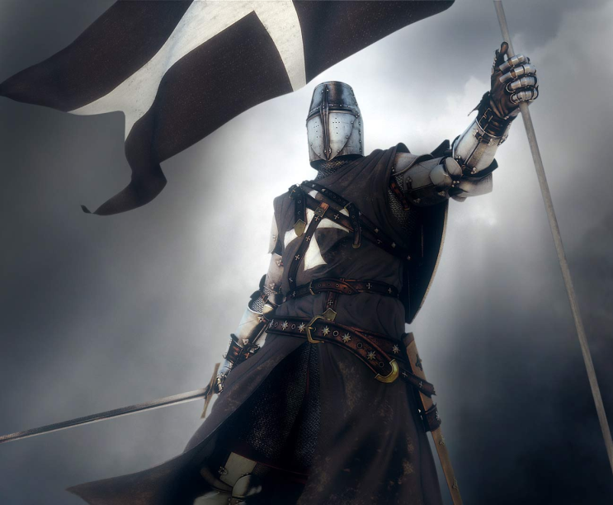
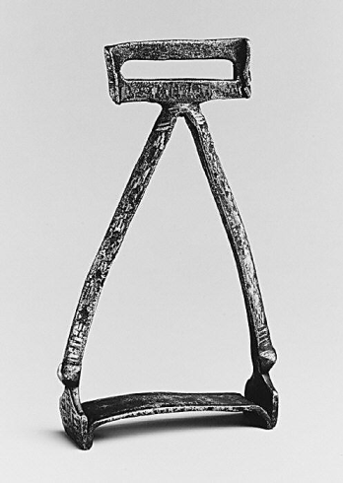
The ‘Knights’ emerge
Feudalism was a way to provide protection and security quickly.
It had one key weakness – the whole system relied upon having LAND to give to people in return for loyalty.
This hunger for land (along with the invasions) resulted in a Medieval Arms race to produce the strongest military and defences.
In this context the creation of heavily armed Knights (now using the stirrups) and castles developed!

Slide 27
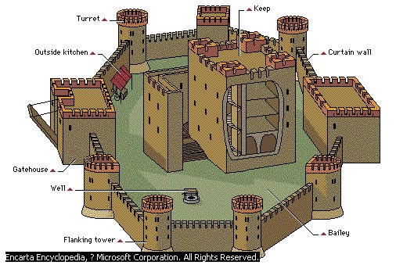

Slide 28
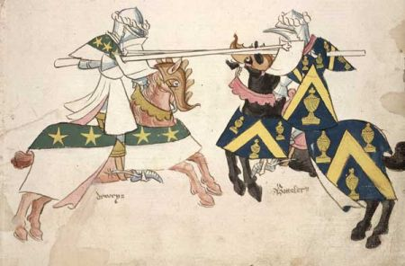
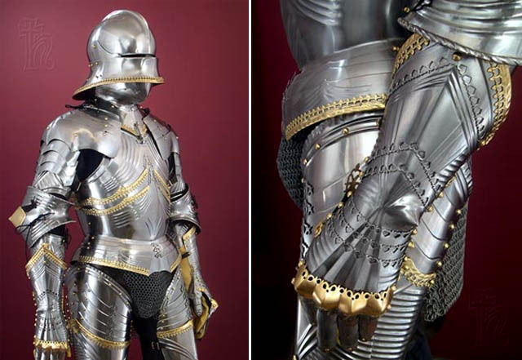
The problems with Knights…
Throughout the Middle Ages the Knight’s armour got heavier and more effective.
On horseback, the medieval knight was a devastating weapon. On foot – the weight of the armour (between 20 and 40kg) made it difficult to move.
Their training improved as jousting competitions were introduced.
As their armour and skills improved violent conflicts over land made travel unsafe for merchants and peasants.
The Catholic Church was so concerned about the violence it passed ‘The Truce of God’ in 1027 to reduce bloodshed.
However, the start of the Crusades in 1096 offered a new opportunity to channel the aggression of the Knights.

Slide 29
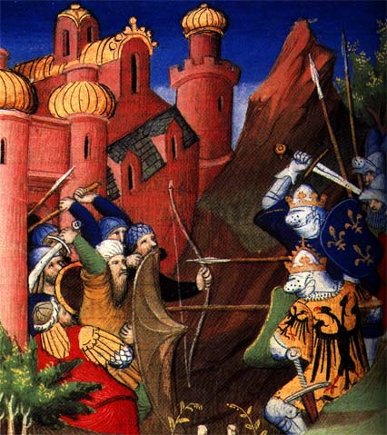
The High Middle Ages (1000-1300)
Key developments:
The wave of invasions stops.
The Holy Roman Empire, France and England begin to build their kingdoms.
The Crusades begin.
Universities emerge.
Political stability leads to economic growth and larger towns and cities.

Slide 30
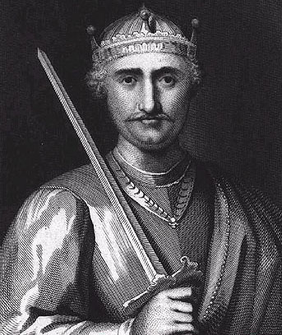
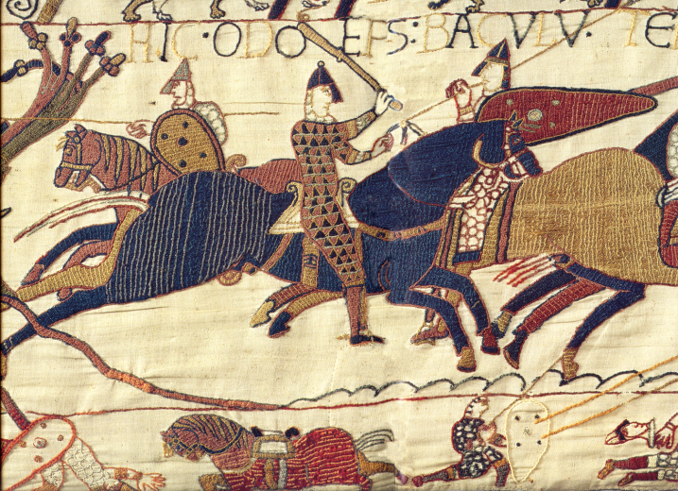
Medieval England
During the early Middle Ages German tribes such as the Angles, Saxons and Jutes invaded Britain.
The name ‘England’ comes from Angleland (named after one of the German tribes).
In 1066 William the Conquerer invaded from Normandy and defeated the English King Harold II (Harold was killed by an arrow through the eye!).
The Battle has been portrayed on the famous Bayeux Tapestry. William was crowned King on Christmas Day.
William introduced a strong and efficient central government.
During the High Middle Ages England would develop a Parliament and the radical concept that the law applied to the King!
It would also wage a series of wars with another rising European power - France.

Slide 31
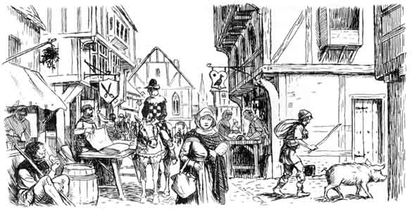
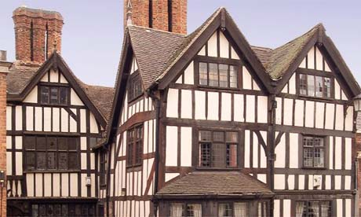
Medieval English Towns and Villages
There were very few towns in early Medieval England. A survey in 1087 counted only six outside of London.
Most towns developed around religious sites or locations such as crossroads and ports where transport was easy.
Towns also developed beside rivers – which could be used for water supplies, transport and sewage disposal (by simply dumping it into the river)

Slide 32
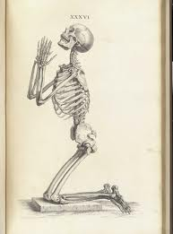
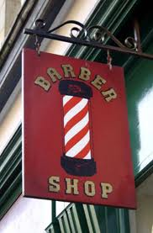
Medieval English Medicine and Technology
The fundamental assumption in medieval medicine was that people became sick because they had sinned.
The church had also banned the practice of ‘doctors’ examining corpses – so the knowledge of anatomy was very limited.
In reality, most doctors were part-time and usually worked as butchers or barbers.
The red and white barber’s poles go back to medieval times (red for blood, white for bandages).
‘Cures’ included the use of leeches to remove ‘bad’ blood and the drilling of holes in patient’s heads to remove bad spirits (to treat mental illness)

Slide 33
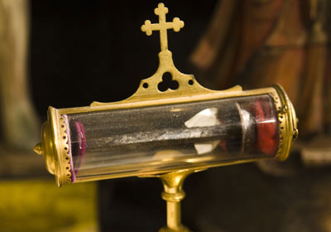
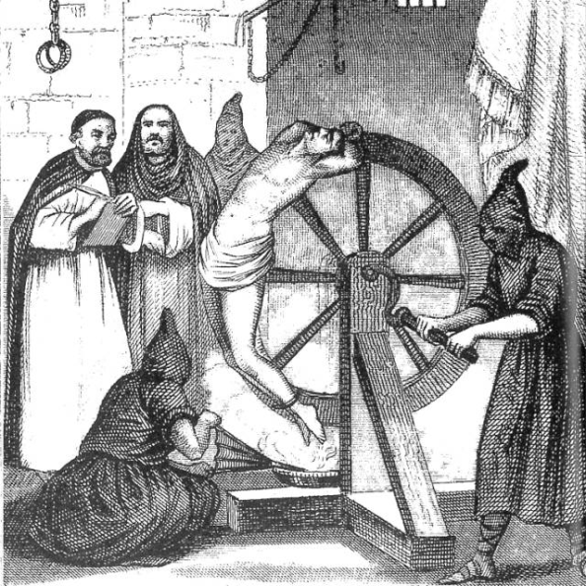
The Church
By the High Middle Ages the church was the largest landowner in western Europe.
They also ran the majority of schools, hospitals and orphanages.
The church occasionally came into conflict with political leaders. The church usually won these conflicts because it was able to:
Excommunicate leaders it disapproved of (throwing them out of the church)
Denying church services to ANYONE living in the ruler’s area (damning them to an eternity in Hell!).
Growing concerns about corruption in the church (including the selling of Church titles by Monks for profit) led to sweeping reforms in this period.

Slide 34
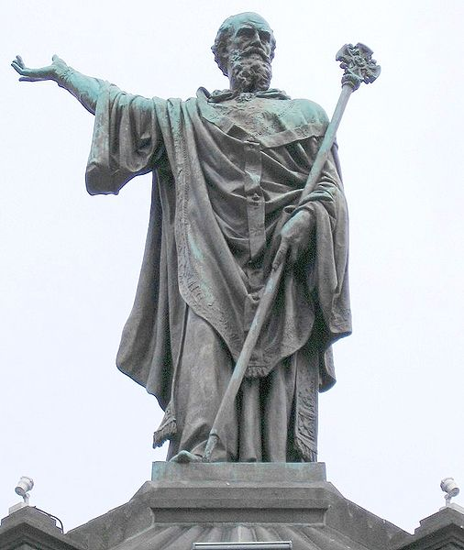
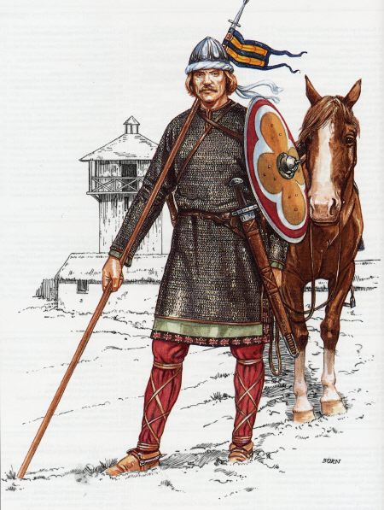
The Crusades (1096 – 1272)
Jerusalem is a sacred city to Muslims, Christians and Jews.
Although Jerusalem had been controlled by Arabs since the 600s the right of Christians to worship had been respected.
In the early eleventh century Turks known as the Seljak Turks seized Jerusalem and closed it to Christians.
The Byzantine Emperor appealed to Pope Urban II to send Knights to take back the Holy Land.

Slide 35
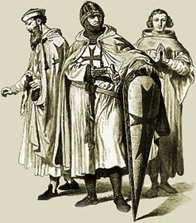
The Crusades – Fast facts
There were 9 Crusades in total.
During some Crusades Jews and Muslims fought together against the Christian ‘invaders’.
The Pope’s motivation for launching the crusades were complex:
There was an obvious religious motivation.
It also removed the warring knights from Western Europe and unleashed them on a foreign land (with the promise of land as a reward).
It could unite the church in a time of great division.

Slide 36
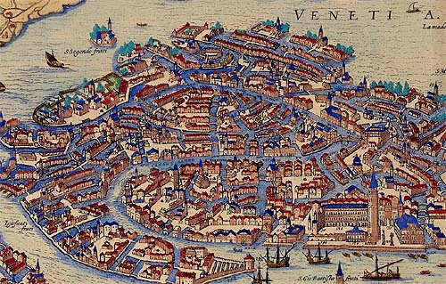
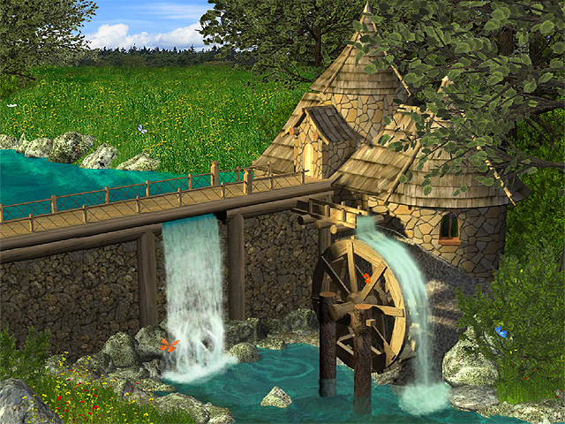
Urban Growth and Life
During the High Middle Ages cities and towns grew dramatically:
Europe was more stable (the threat of invasion had gone and the Knights were away on crusades – not warring at home).
The Crusades united many European Kingdoms and the movements of large numbers of crusaders encouraged trade.
New inventions resulted in improved harvests (e.g. water mills and better plows)
The population boomed from the years 1100-1300. Good times!

Slide 37
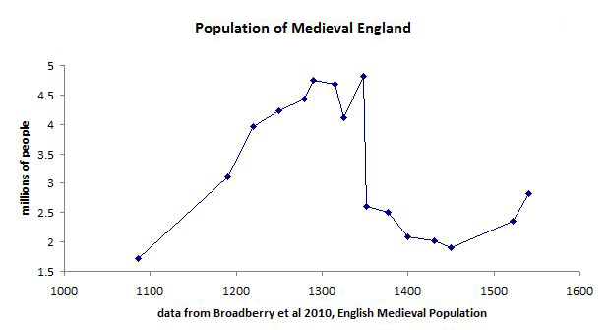
The Late Middle Ages (1300-1500)
Key Events:
Climate change and famine
The Black Death
The Hundred Year’s War between England and France
The power of the church is challenged.
The end of the Middle Ages.

Slide 38


Climate Change and Famine
During the 1300s and 1400s the temperature of Europe began to cool.
This resulted in violent storms and unpredictable rainfall.
Crop yields dropped dramatically.
The worst years were 1315-1317.
In most towns and regions 10 to 50 per cent of the population starved to death.
The famine lead to a dramatic increase in violent crime and there were widespread reports of cannibalism.
The powerlessness of Church and Kings to deal with the crisis began to raise questions….

Slide 39

Key Event: TheBlack Death (1348-1350)
As trade had expanded in the 1300s Europeans had more regular contact with Asia.
The Silk Road was the main route between Europe and China.
Tensions occurred along this route between Europeans and the Mongolian tribesman (Mongols).
Italian merchants at the city of Kaffa were besieged by the Mongols in 1345.
As the Mongol’s started dying because of a mysterious illness they adopted a new strategy – hurling the bodies of the dead over the Italian city walls.

Slide 40


Black Death (1348-1350)
The disease killing the Mongols was the Bubonic Plague.
During medieval times there was no cure for this disease – and it was spread easily.
The Italian merchants returned to their port city and the disease spread rapidly throughout Europe.
Symptoms included large blisters called Buboes, high fevers and delirium.
‘Cures’ such as donating gold to the church, self-flagellation and using leeches to drain blood had no effect.

Slide 41


Slide 42

Black death - impacts
1/3 of Europeans are killed.
Jews are blamed – leading to anti-semitic attacks.
The authority of the church was questioned.
So many workers were killed that the remaining workers could argue for better conditions.

Slide 43

The world after the Middle Ages
The Late Middle Ages (1300-1500) had been a time of climate change, war, famine and poverty.
Despite these events there were several reasons the period from 1500 was the beginning of Modern Europe.
Cities in Italy were rediscovering the influence of Greek and Roman culture. This would lead to a Renaissance of ideas from these periods.
European nations began to explore the world (most importantly Columbus discovered America in 1492).
Nations such as France, England, Spain, Switzerland and Russia were more united and determined to protect their independence.

